Slide 1


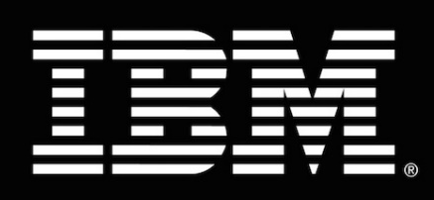
Worhshop: OpenShift
Paola Andrea Casanova, Jessica Barreto, Luis Felipe Martinez
Customer Success Manager team

Slide 2
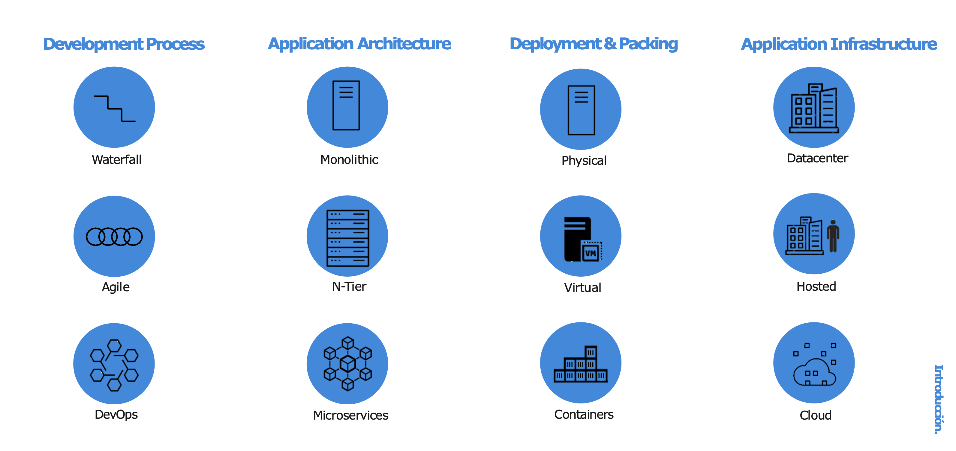

a container is the smallest compute unit

Slide 3
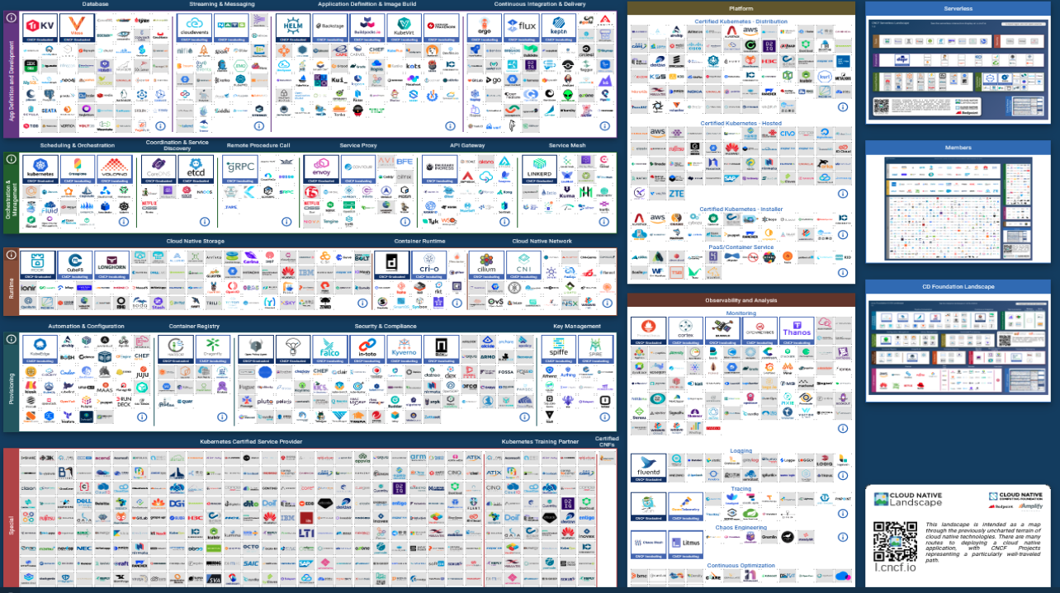

Slide 4
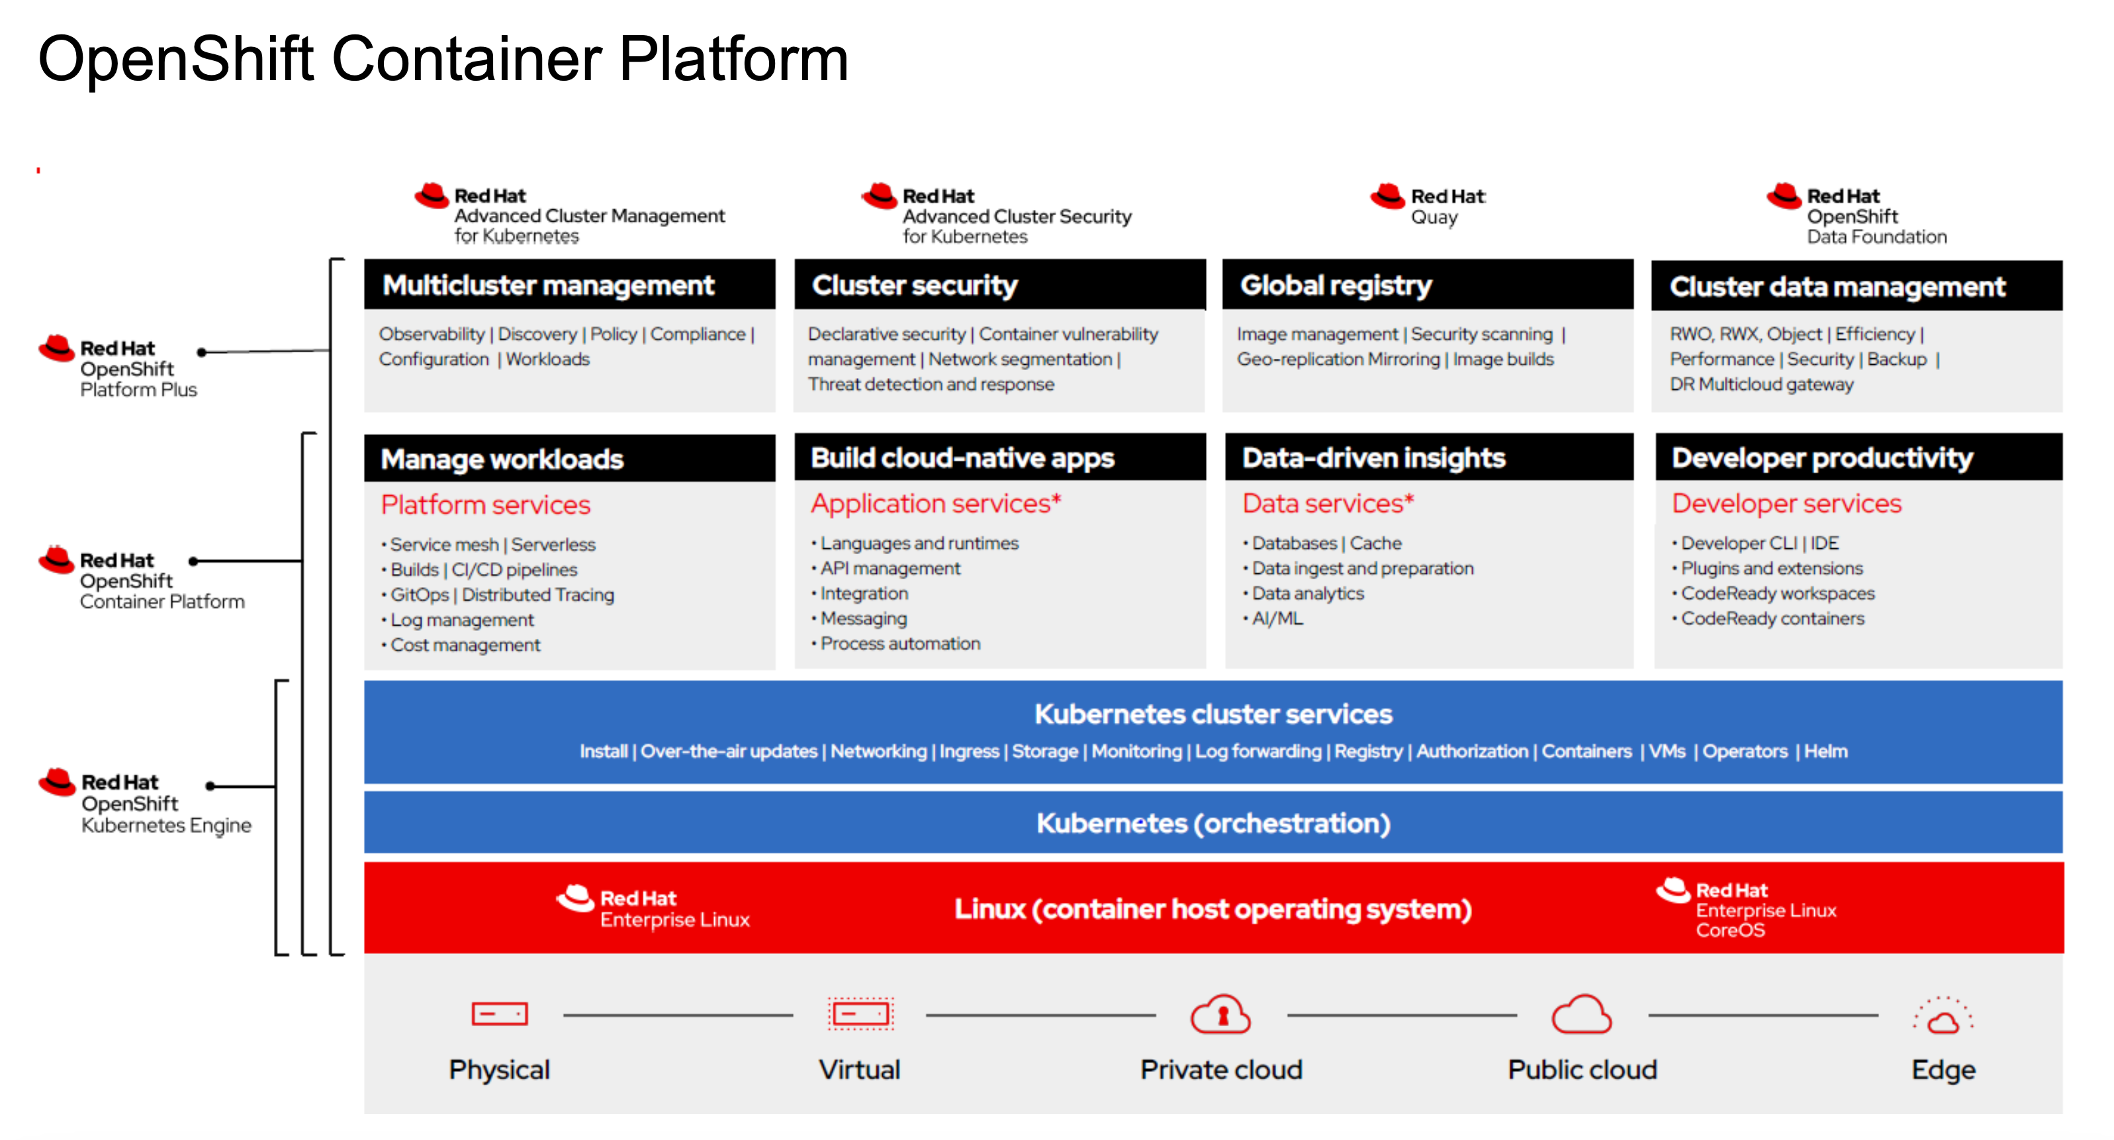
Notes:
.

Slide 5


OpenShift architecture

Slide 6
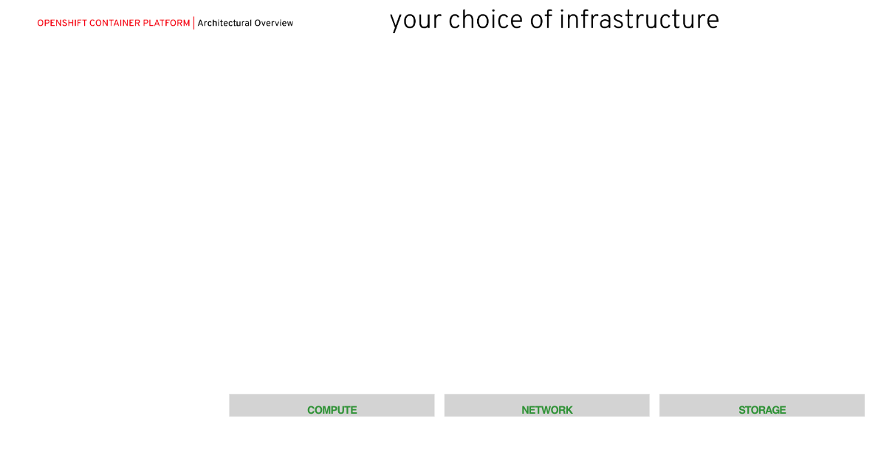

Slide 7
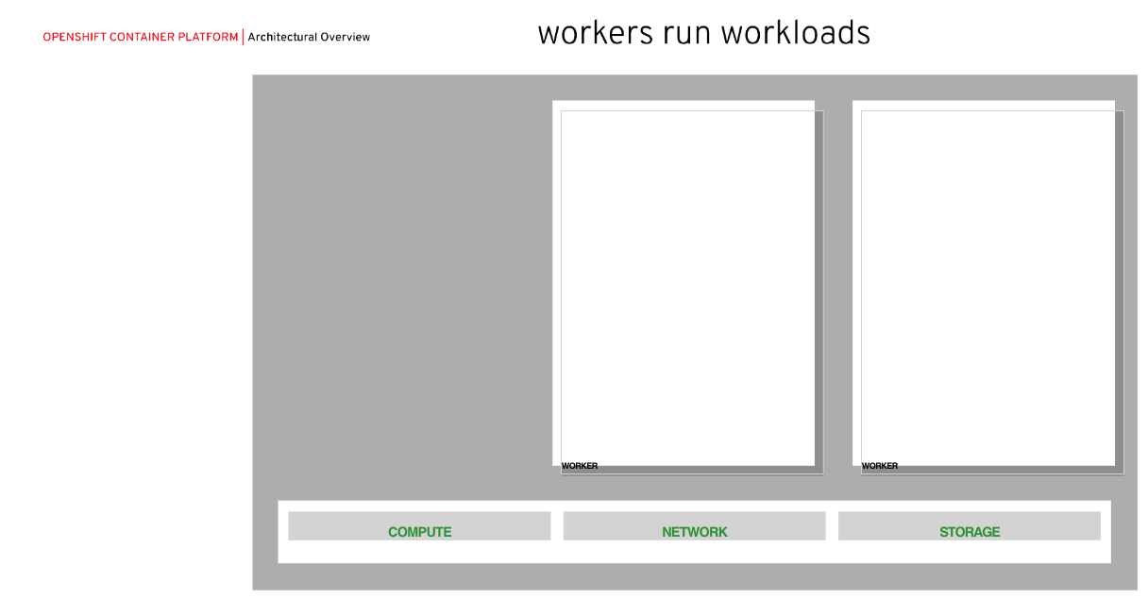

Slide 8
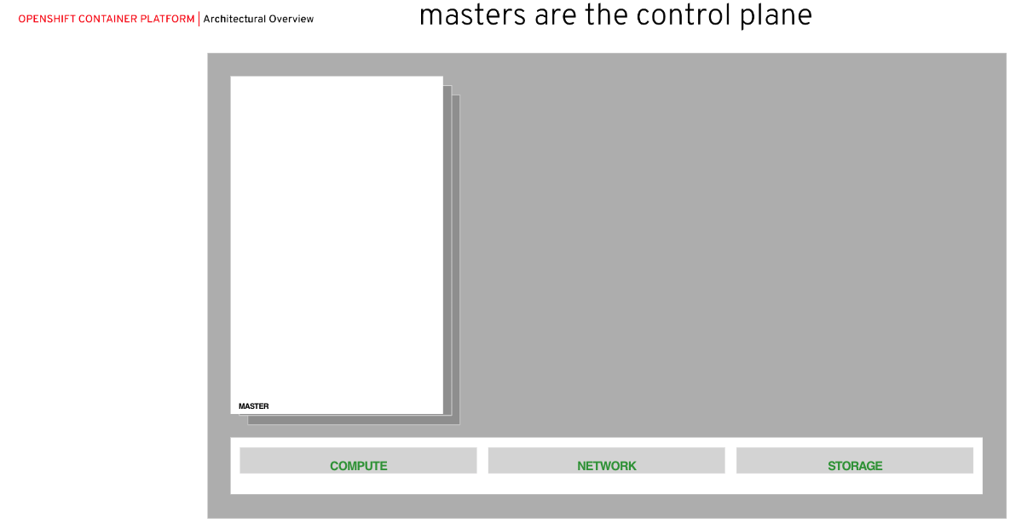

Slide 9
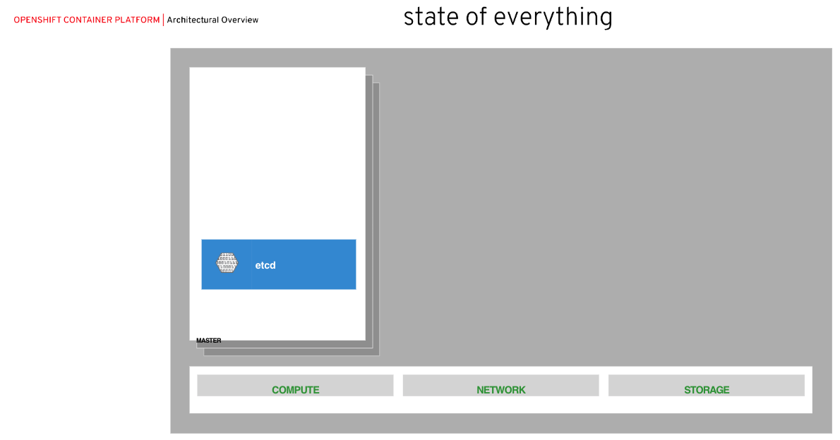

Slide 10
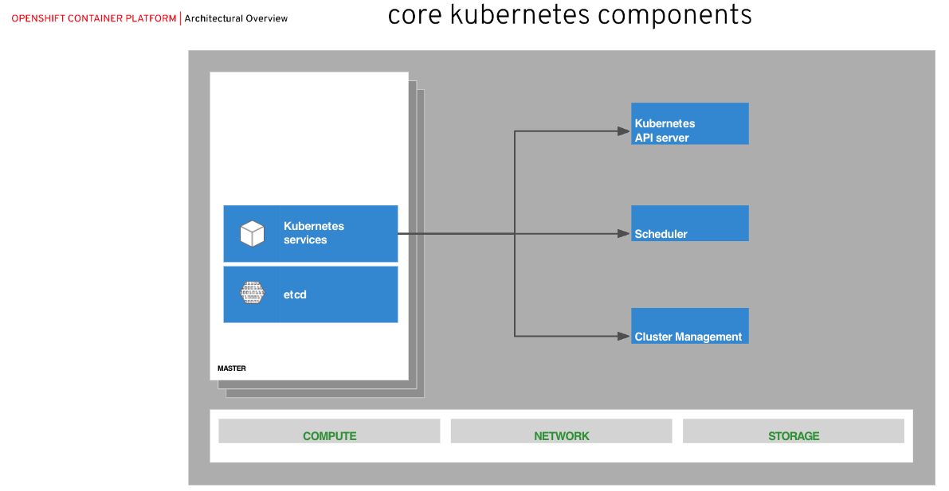

Slide 11
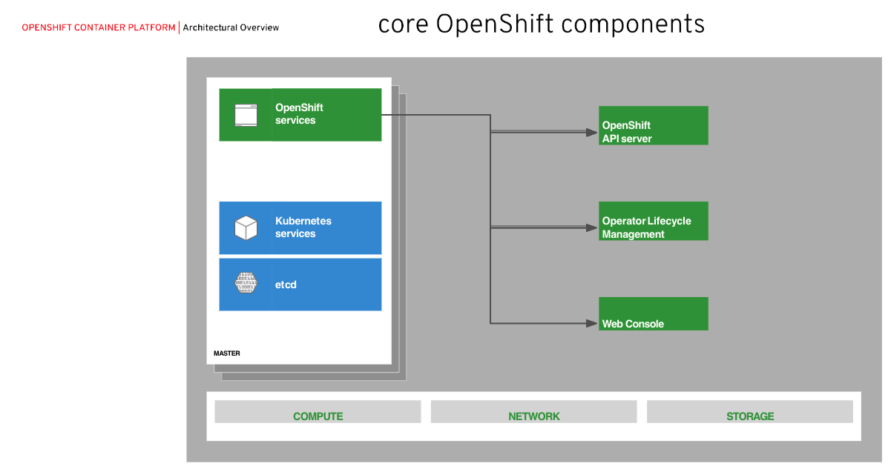

Slide 12
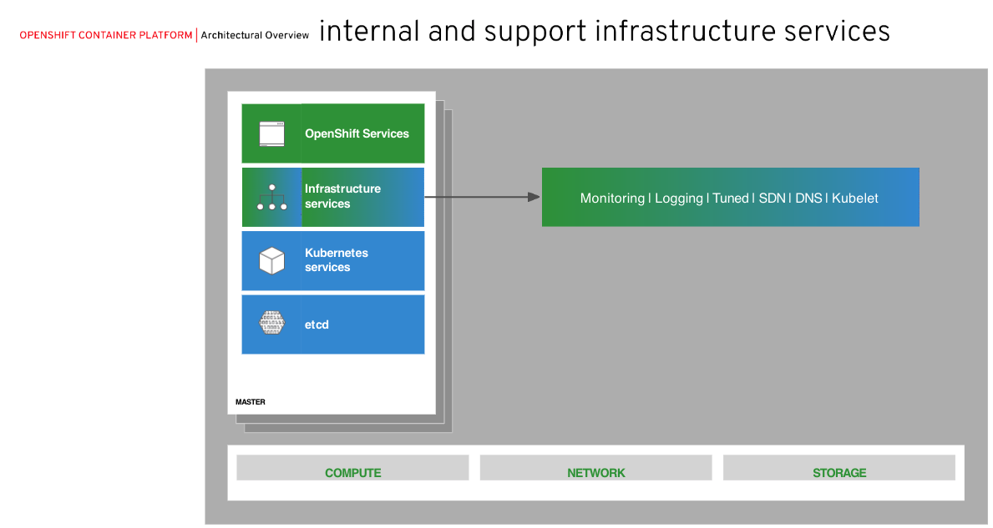

Slide 13
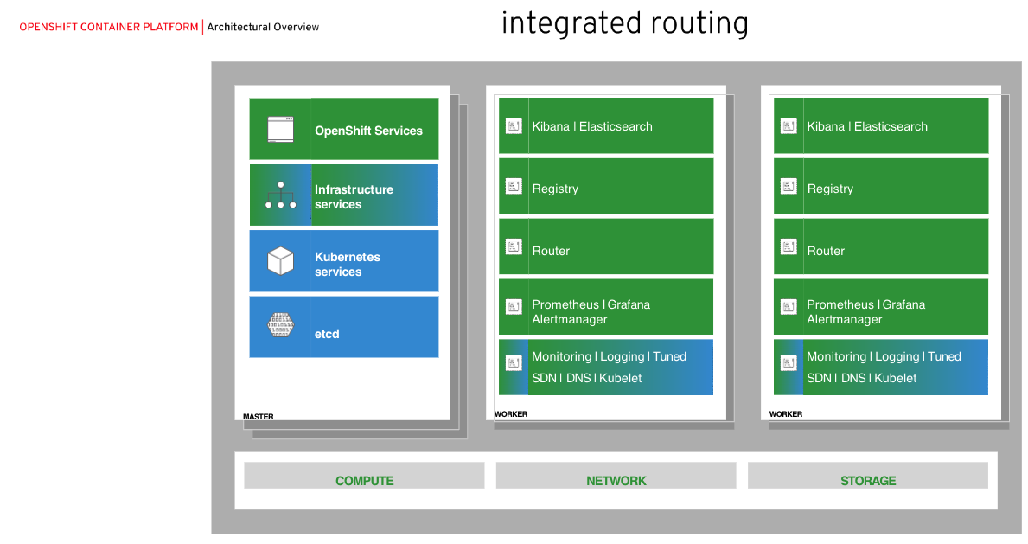

Slide 14
OpenShift vs Kubernetes

Slide 15
Understanding Kubernetes, OKD, OpenShift relationship
Kubernetes is an open source project which provides management of containerized workloads and services.
Kubernetes is a key building block which is an integral part of building an enterprise Kubernetes Platform (there are over 90 CNCF Certified Kubernetes offerings) which can be combined with additional external systems / services to build a enterprise level PaaS system
OKD is the upstream open source Origin Community Distribution of Kubernetes that powers Red Hat OpenShift
OKD is a distribution of Kubernetes optimized for continuous application development and multi-tenant deployment. OKD adds developer and operations-centric tools on top of Kubernetes to enable rapid application development, easy deployment and scaling, and long-term lifecycle maintenance for small and large teams. OKD is the upstream Kubernetes distribution embedded in Red Hat OpenShift.
OKD embeds Kubernetes and extends it with security and other integrated concepts. OKD is also referred to as Origin in GitHub and in the documentation.
Red Hat OpenShift is a downstream enterprise level production product with a paid subscription that entitles enterprise level support based on the OKD open source product.
Red Hat OpenShift offers automated installation, upgrades, and lifecycle management throughout the container stack—the operating system, Kubernetes and cluster services, and applications—on any cloud.
Red Hat OpenShift helps teams build with speed, agility, confidence, and choice. Code in production mode anywhere you choose to build. Get back to doing work that matters.
Red Hat OpenShift is focused on security at every level of the container stack and throughout the application lifecycle. It includes long-term, enterprise support from one of the leading Kubernetes contributors and open source software companies.
Notes:
It is important to understand the relationship of Kubernetes, OKD and OpenShift. Kubernetes is the core with OKD integrating additional critical capabilities of other opensource projects. Trying to down OKD and putting it into a production environment is challenging as there are many security aspects, lifecycle maintenance aspects and the need to be able to count on someone to call 24 x 7 when there is a problem with the environment. OpenShift takes OKD and makes it enterprise ready for mission critical production workloads.

Slide 16
OCP vs DIY Kubernetes
Container orchestration | Kubernetes |  | Kubernetes
Container image | OCI-compliant/docker |  | BYO OCI-compliant
Container runtime | CRIO/docker |  | BYO OCI-compliant engine
Container build | RHCC/S2I/dockerfile
Container registry | Quay/OSS docker registry
Container scanner | Clair
CI/CD automation | OCP Pipelines/Tekton
IDE | Che/Code Ready workspaces
Web UX | Web console (admin and developer perspectives) |  | Web console
CLI UX | oc/odo/kubectl |  | kubectl
Service catalog | Operators
Secrets management | Kubernetes Secrets |  | Kubernetes Secrets
Supported/preferred runtime | RHOAR (EAP, Spring, vert.x, node.js)

Slide 17
OCP vs DIY Kubernetes
Service mesh | Istio, Jaeger, Kiali, Prometheus&Grafana
Logging | EFK
Metrics | Prometheus/Grafana
Storage | OpenShift Container Storage
Network | OVN -(TechPreview)
Ingress | Kubernetes Ingress/Routes |  | Kubernetes Ingress
Ingress controller | HA Proxy
Egress | Egress Router
Authentication | Kubernetes Auth/RH-IdM |  | Kubernetes Auth
App isolation | Kubernetes scheduler |  | Kubernetes Scheduler
Infrastructure | Bare metal, vSphere, KVM, OpenStack, AWS, GCP, Azure |  | BYO Linux
Infra automation | Ansible/Operators
Infra management | Admin Console
Operating system | RHEL or RHEL CoreOS
CNCF Certified Kubernetes

Slide 18
Customer Actions
 | RH Managed Services | xKS
Platform Issue | Auto-heal / Open Support Ticket | Search forums
CI/CD | S2I, Jenkins, Imagestreams built in | Add provider service and configure
Logging | EFK Stack (OSD) / Azure Monitor (ARO) | Add provider service and configure
Metrics/Monitoring | Prometheus and Grafana / Azure Monitor (ARO) | Add provider service and configure
Updates | Red Hat Managed | Mix of auto and manual
Upgrades | Red Hat Managed | Mix of auto and manual
Notes:
View of what Red Hat Manages for you vs what you would have to do on your own on another Kube Service. OpenShift provides these options out of the box - Those are separate services that you must find, manage and keep up to date on your own with xKS.
CICD
AWS CodeBuild
Azure Pipelines
Logging
AWS CloudWatch
Azure Monitor

Slide 19
OpenShift benefits!

Slide 20



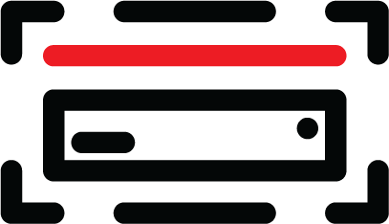



OpenShift Container Platform
Advanced Cluster Management
Multi-cluster Management Discovery ⠇Policy ⠇Compliance ⠇Configuration ⠇Workloads
Manage Workloads
Build Cloud-Native Apps
Developer Productivity
Platform Services
Application Services
Developer Services
OpenShift Container Platform
Service Mesh ⠇Serverless Builds ⠇CI/CD Pipelines
Full Stack Logging Chargeback
Databases ⠇Languages Runtimes ⠇Integration Business Automation 100+ ISV Services
Developer CLI ⠇VS Code extensions ⠇IDE Plugins Code Ready Workspaces CodeReady Containers
Cluster Services Automated Ops ⠇Over-The-Air Updates ⠇Monitoring ⠇Registry ⠇Networking ⠇Router ⠇KubeVirt ⠇OLM ⠇Helm
Kubernetes
Red Hat Enterprise Linux & RHEL CoreOS
Edge
Physical
Virtual
Private cloud
Multi-Arch
Public cloud
Managed cloud
(Azure, AWS, IBM, Google)

Slide 21
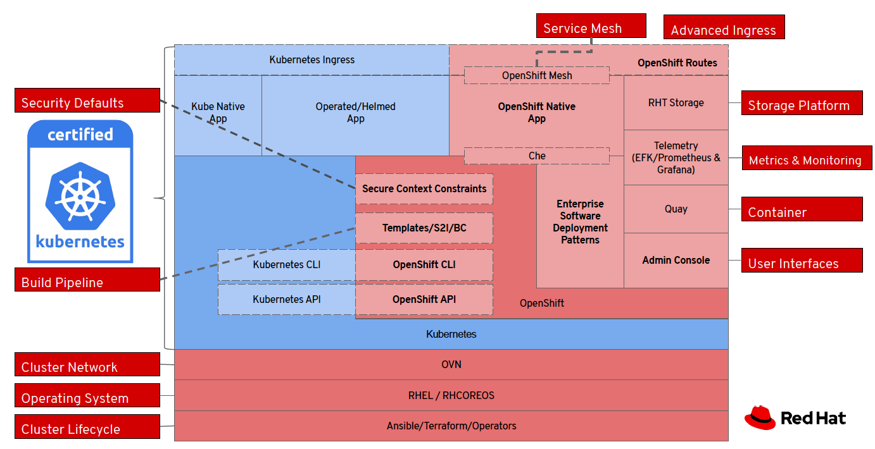
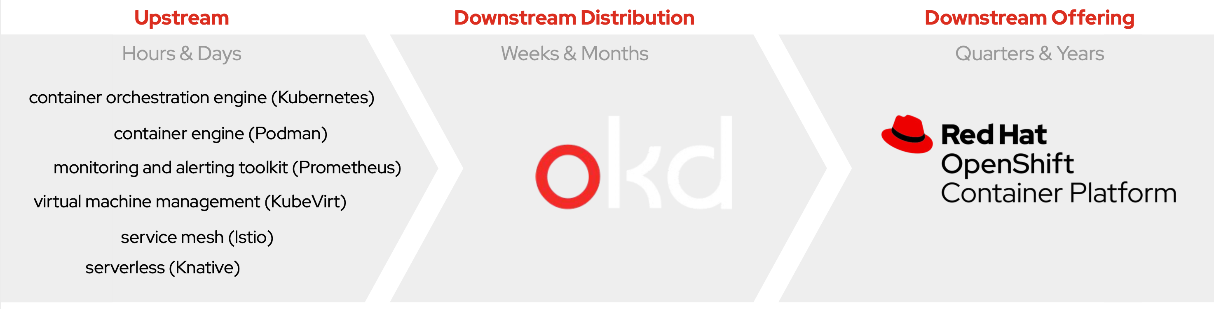
OpenShift integrates and packages into an enterprise consumable container platform
In order to consume a secure, enterprise strength container platform then considerable ongoing effort is required to maintain its currency and compliance.
OpenShift “as product” provides more value than simply a Buy vs Build measure, its pre-integrated and pre-tested continual delivery model reduces over cost of ongoing operations and risk compliance.
Vanilla Kubernetes
Open Source
Service Mesh
App-Services
DB-Services
CI/CD
DNS
Authentication
Monitoring
Kubernetes
Automation
Logging
Registry
Security
Compute
Storage
Network
200+ validated integrations
100s of defect and performance fixes
9 year enterprise lifecycle management
Security fixes
Middleware integration (container images, storage, networking, cloud services, etc)
Certified Kubernetes

Slide 22
Building a Platform is not YOUR business focus
Service Mesh
App-Services
DB-Services
OpenShift allows your technology teams to focus on building business value, not focusing on building technology platforms
xKS services are NOT free, and not simple
CI/CD
DNS
Authentication
Monitoring
xKS Service
Automation
Logging
Registry
Security
Compute
Storage
Network
xKS Services are Kubernetes Cloud lock-in
10-20+ individual services needed to make a platform
Customer must do integrations and maintenance
All non-xKS Services priced differently
All non-xKS Services supported individually
Additional costs and
integrations
Notes:
xKS Services are NOT free, and not Simple
Consider the costs to purchase, manage, update, secure and integrate each of these separate services yourself
Managed OpenShift manages each of these services for the customer. Ensuring they are integrated, up to date, covered by the latest security patch, etc.
This takes a tremendous amount of effort OFF the customer’s plate to give them time to focus on their business and building innovative applications.

Slide 23
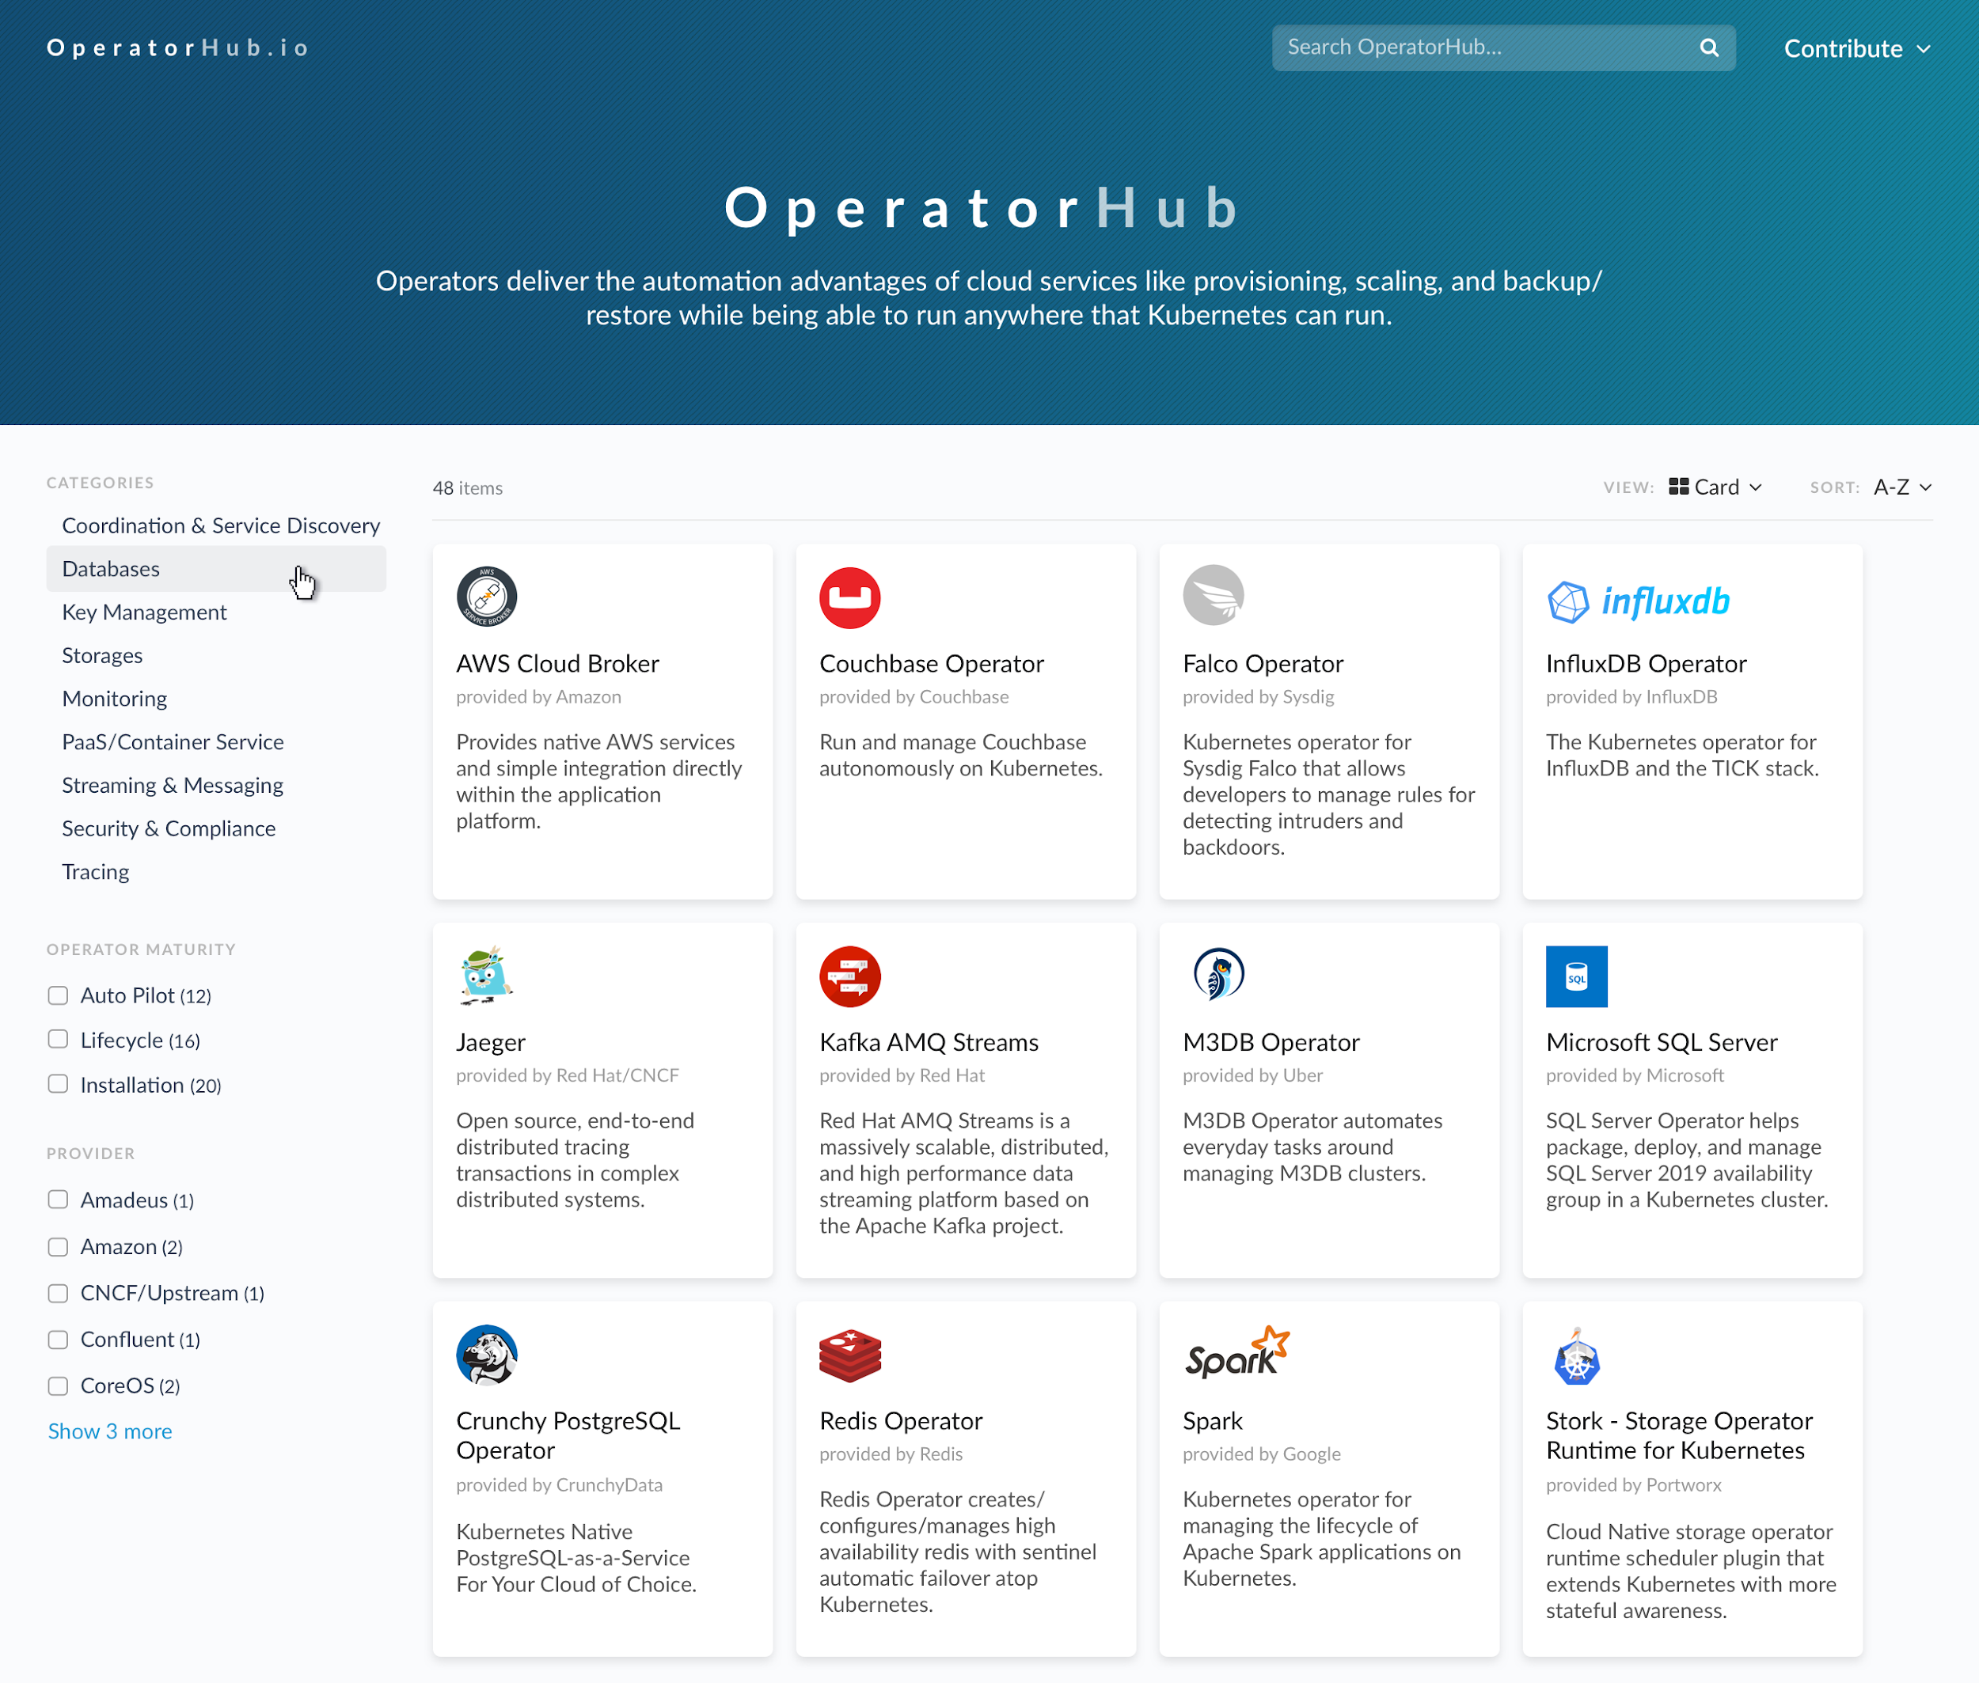
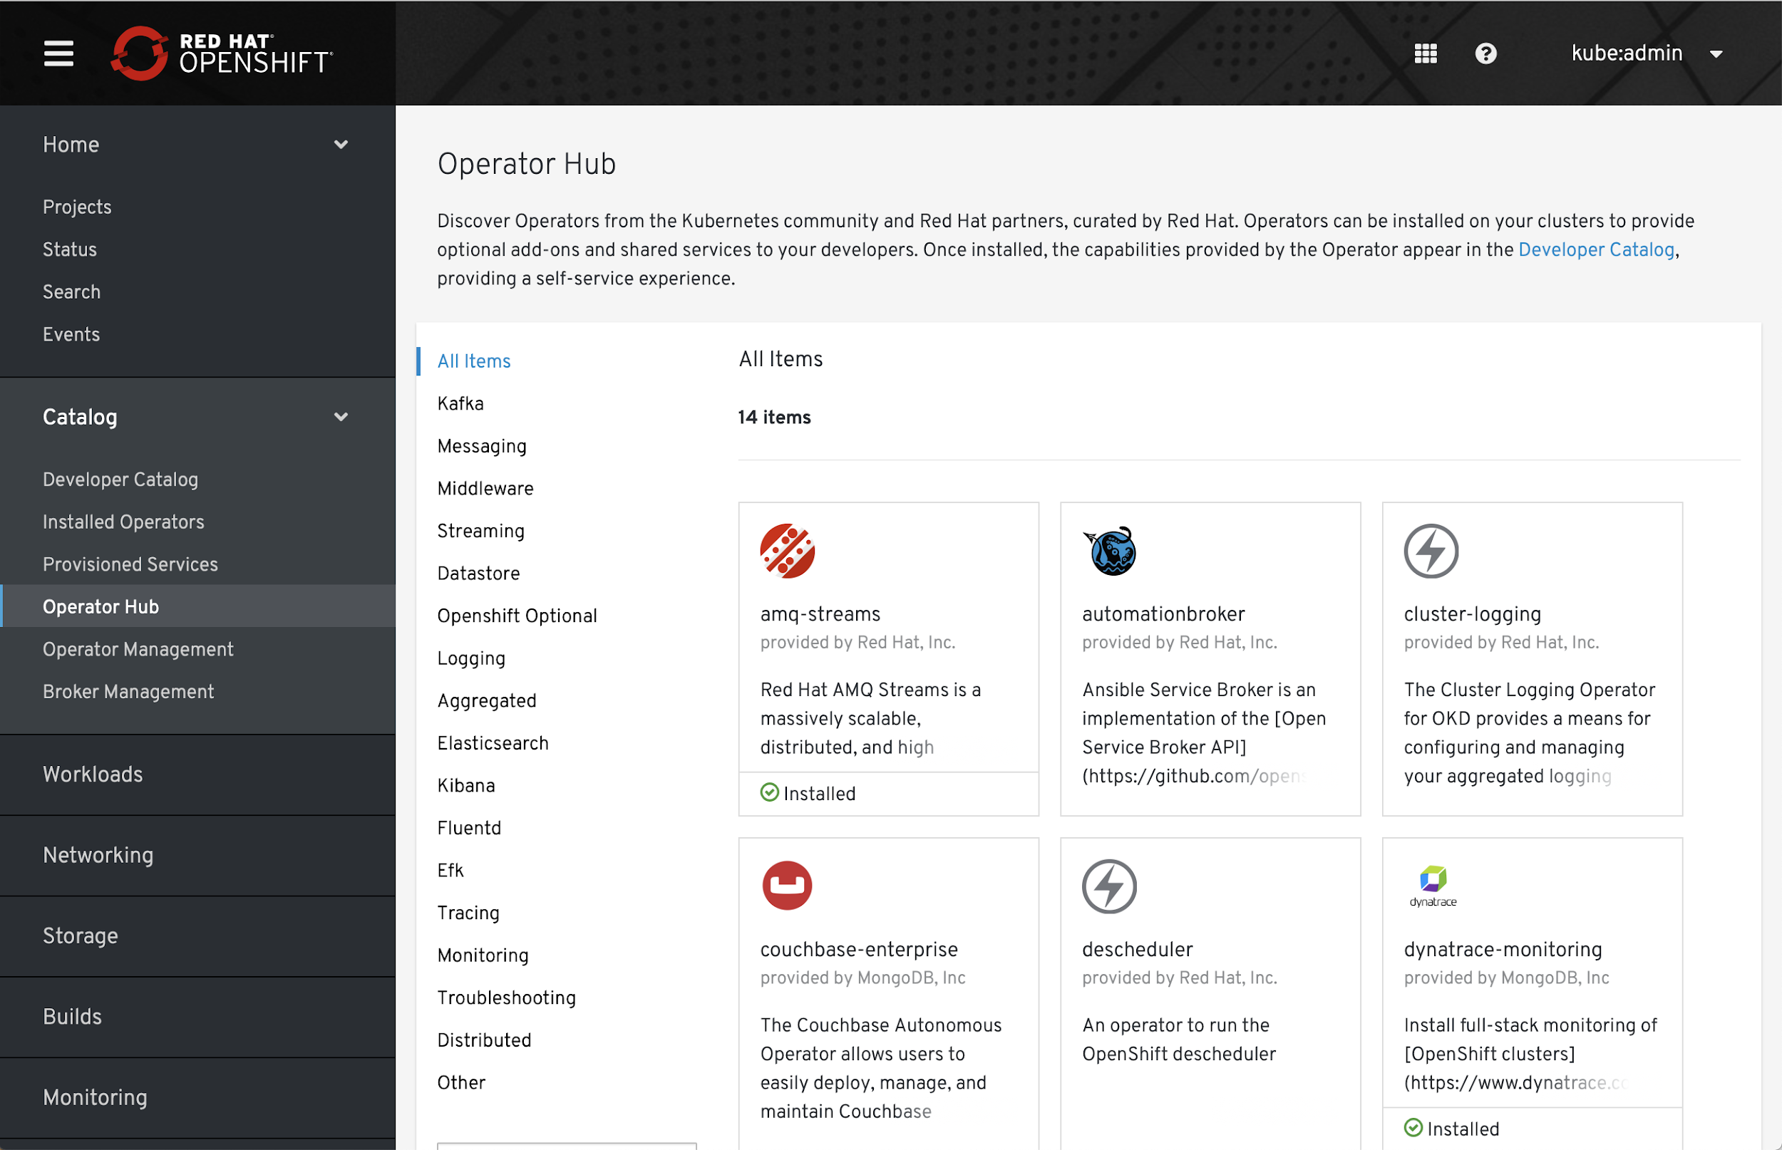
Operator Hub and Certified Operators
OperatorHub.io launched by Red Hat, AWS, Microsoft, and Google
OpenShift Operator Certification
Operator Hub integrated into OpenShift 4
COMMUNITY OPERATORS
OPENSHIFT CERTIFIED OPERATORS
Notes:
So how do you get these operators?
The Operator Hub was launched by Red Hat and our launch partners AWS, Microsoft and Google earlier this year. It provides a single place on the internet for developers to publish operators and for customers to find and consume curated operators. These operators meet certain quality standards so you can have the confidence they deliver what they promise. You can deploy these operators on any Kubernetes distribution, not just OpenShift.
But we’ve also integrated the OperatorHub into OpenShift where you can also find fully certified operators from our partners that meet a very high bar of quality standards.

Slide 24
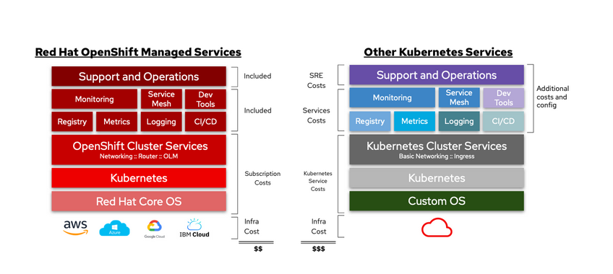
Comparing Managed OpenShift to Managed xKS
What is your total cost of ownership (TCO)?
There is more to the total cost of Kubernetes than the infrastructure itself. Do you have the resources to support and operate your clusters 24x7x365, or do you need enterprise support? Could your internal talent be better tasked with creating innovative solutions to your customer’s problems? You’ll also want to factor in service costs such as monitoring, logging, security, service mesh, and building CI/CD pipelines; all critical services that aren’t part of a basic Kubernetes deployment. The costs and time to implement the features you need add up fast. With a Red Hat OpenShift Managed service, we take the burden off you. Let us reduce the operational complexity, accelerating your time to market by allowing you to focus on building and scaling applications that add more value to your business.
https://www.openshift.com/products/pricing/?extIdCarryOver=true&sc_cid=701f2000001OH7TAAW

Slide 25


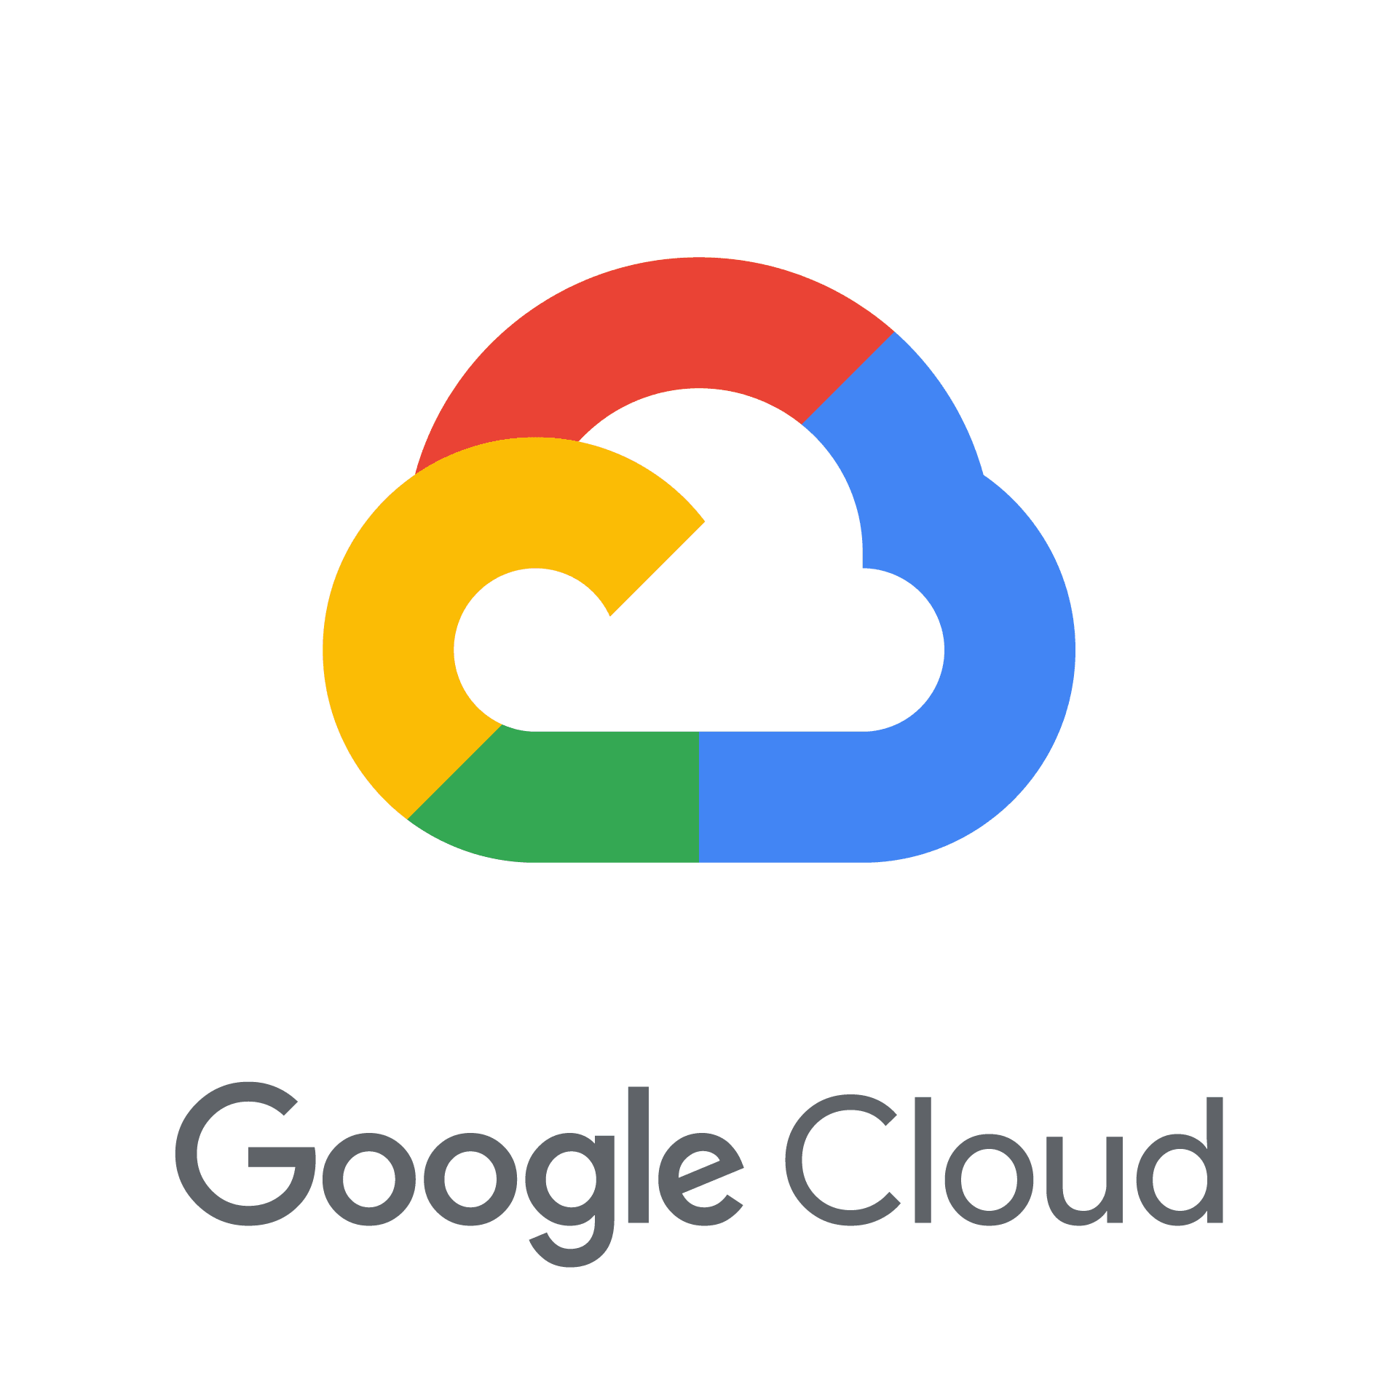
Updated Total Cost of Ownership
New Pricing!
1 Multi-AZ cluster / 9 Worker Nodes / 1 Year / USD
OpenShift Dedicated
xKS
Support and Operations
Included
$65,000*
Support and Operations
Additional costs and config
Monitoring
Service Mesh
Dev Tools
Monitoring
Service Mesh
Dev Tools
Included
$15,000
Registry
Metrics
Logging
CI/CD
Registry
Metrics
Logging
CI/CD
OpenShift Cluster Services
Networking :: Router :: OLM
Kubernetes Cluster Services
Basic Networking :: Ingress
Kubernetes
$9,000
$876
Kubernetes
Red Hat Core OS
Custom OS
$35,000
$18,000
$44,000
$98,876
*Operations: Conservative estimate of 0.5 FTE
See detailed version of calculations here
Notes:
New TCO with updated pricing - our total cost decreased from ~$71,000 to ~$44,000 and therefore making our TCO significantly lower than other Kube Services.

Slide 26
OpenShift and Kubernetes core concepts

Slide 27
a container is the smallest compute unit

Slide 28
containers are created from container images
IMAGE
CONTAINER
BINARY
RUNTIME
Notes:
.

Slide 29
container images are stored in an image registry
IMAGE REGISTRY

Slide 30
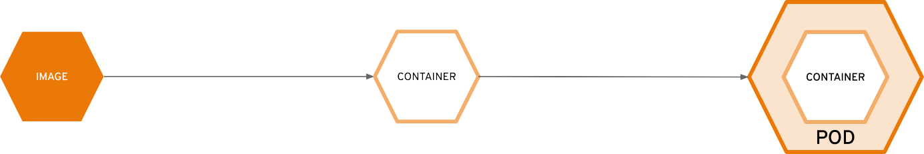
10.140.4.44

Slide 31
ReplicationControllers & ReplicaSets ensure a speciﬁed number of pods are running at any given time
image name replicas labels cpu memory storage
ReplicaSet ReplicationController

Slide 32
Deployments and DeploymentConfigurations deﬁne how to roll out new versions of Pods
image name replicas labels version strategy
Deployment DeploymentConﬁg

Slide 33

a daemonset ensures that all (or some) nodes run a copy of a pod
Node
foo = bar
Node
foo = bar
Node
foo = baz
image name replicas labels cpu memory storage
DaemonSet

Slide 34
configmaps allow you to decouple conﬁguration artifacts from image content
Dev
appconfig.conf MYCONFIG=true
ConﬁgMap
Prod
appconfig.conf MYCONFIG=false
ConﬁgMap

Slide 35
secrets provide a mechanism to hold sensitive information such as passwords
Dev
hash.pw ZGV2Cg==
ConﬁgMap
Prod
hash.pw cHJvZAo=
ConﬁgMap

Slide 36
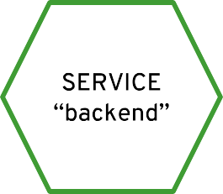
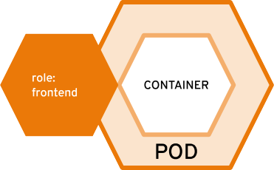
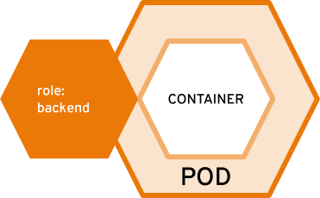


services provide internal load-balancing and service discovery across pods
role: backend
10.140.4.44
10.110.1.11
10.120.2.22
10.130.3.33

Slide 37
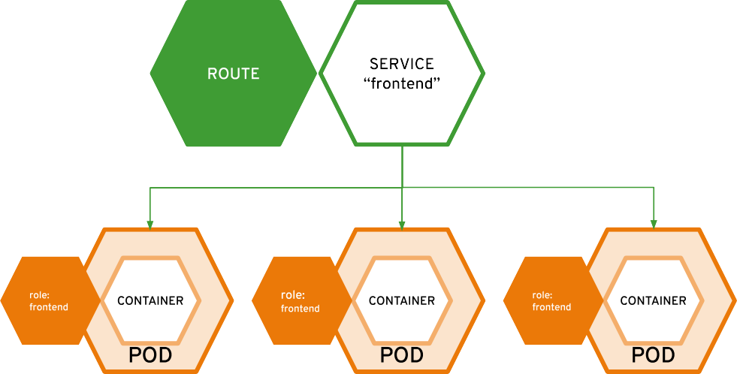
routes make services accessible to clients outside the environment via real-world urls
app-prod.mycompany.com
> curl http://app-prod.mycompany.com
role: frontend

Slide 38
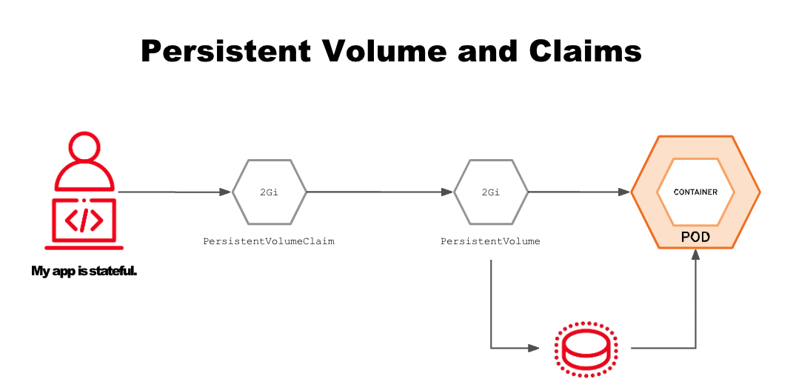

Slide 39
Developer View

Slide 40
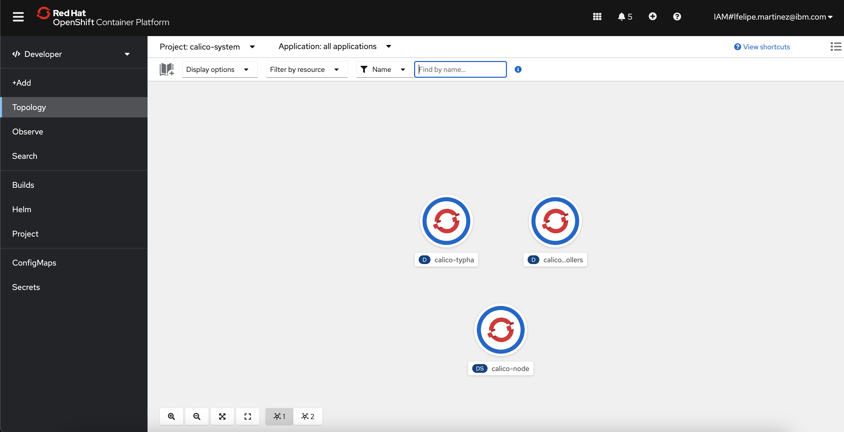
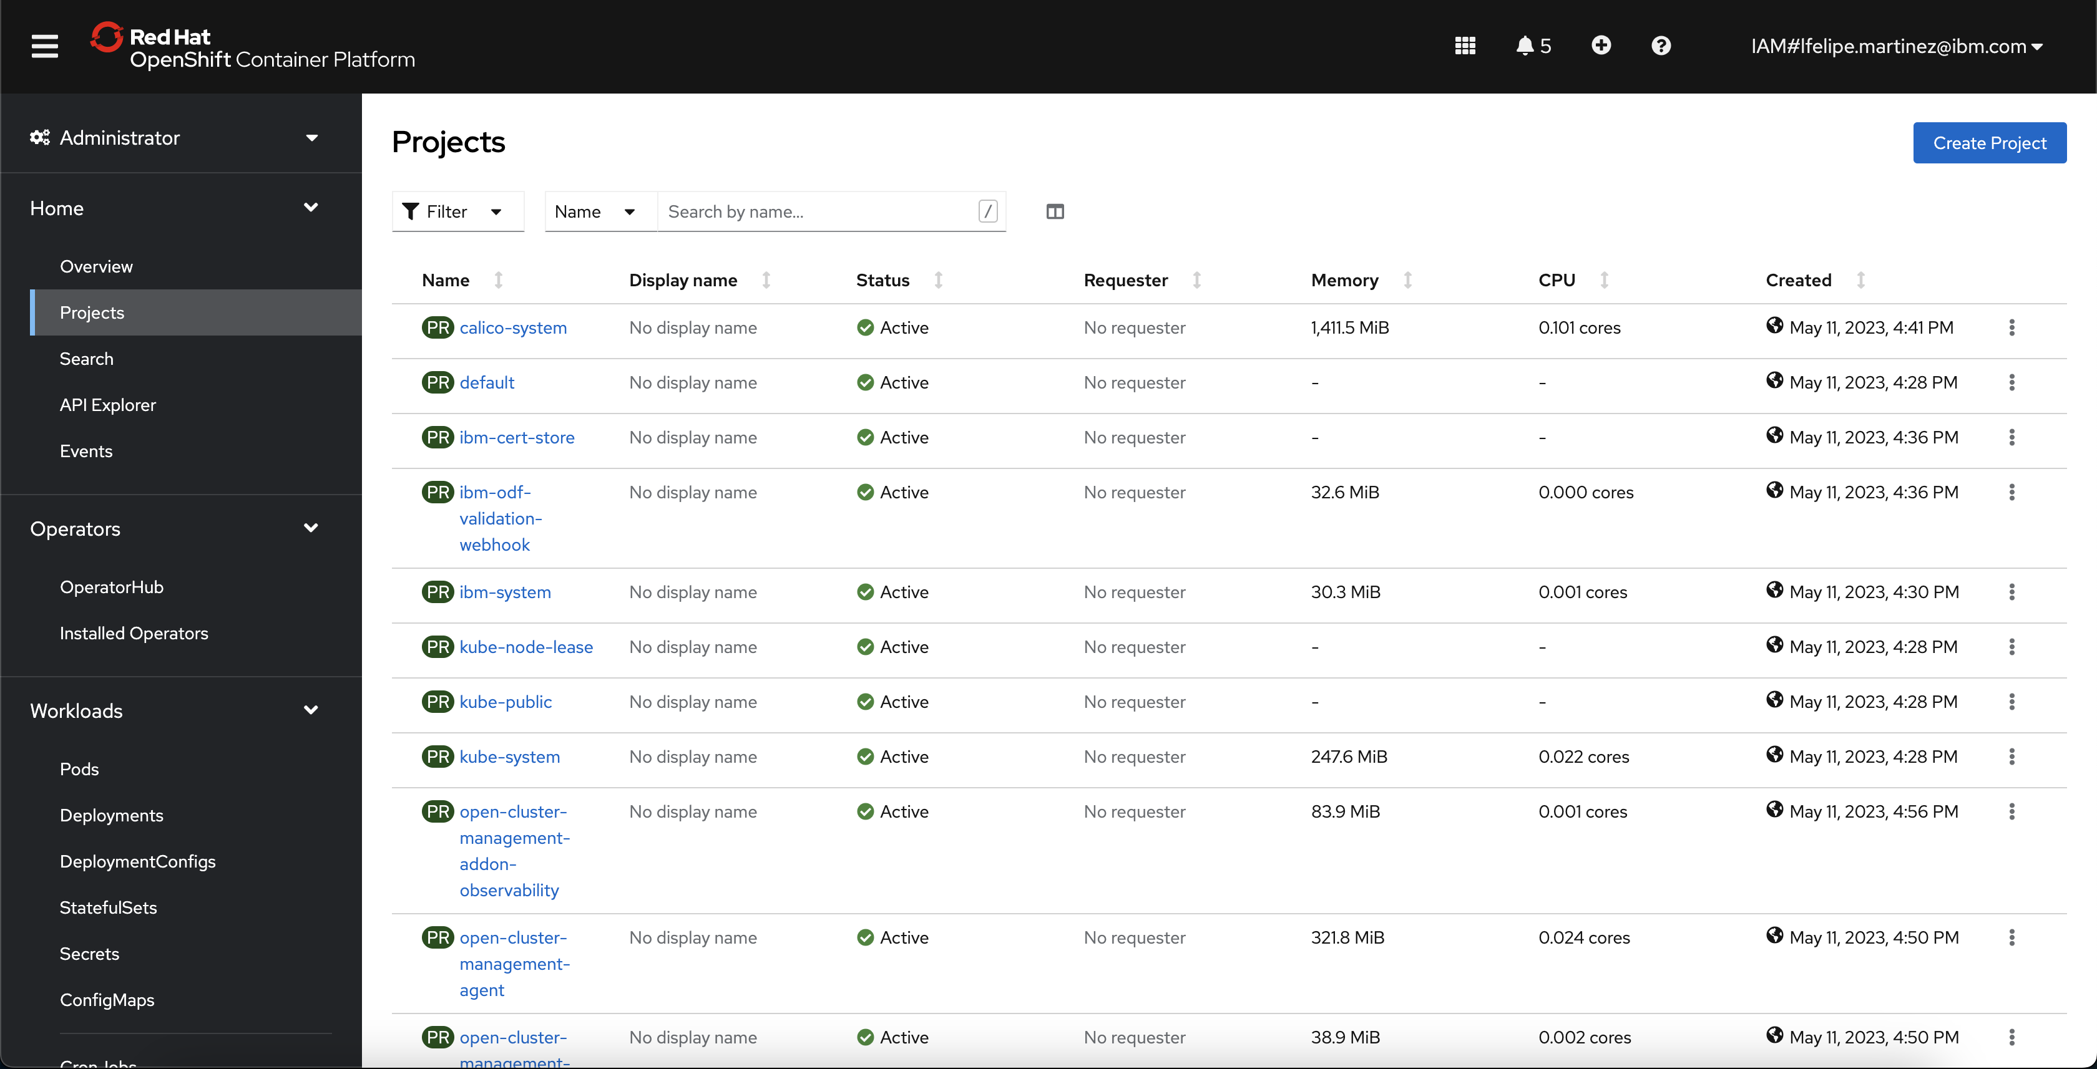
Notes:
New TCO with updated pricing - our total cost decreased from ~$71,000 to ~$44,000 and therefore making our TCO significantly lower than other Kube Services.

Slide 41
Admin view

Slide 42
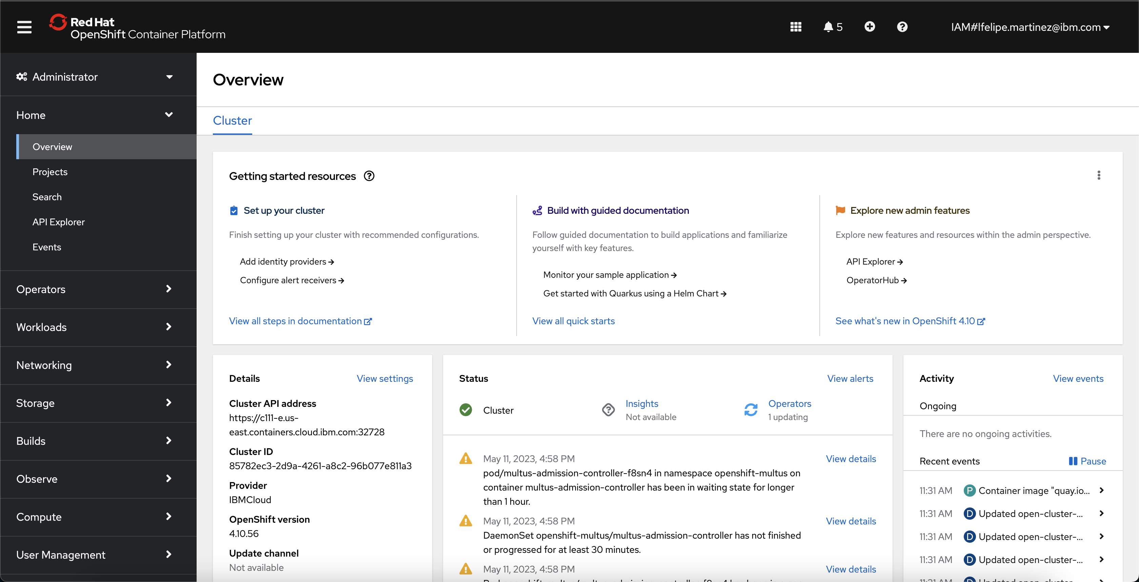
Notes:
New TCO with updated pricing - our total cost decreased from ~$71,000 to ~$44,000 and therefore making our TCO significantly lower than other Kube Services.

Slide 43
Namespaces

Slide 44
Notes:
New TCO with updated pricing - our total cost decreased from ~$71,000 to ~$44,000 and therefore making our TCO significantly lower than other Kube Services.

Slide 45
Monitoring

Slide 46
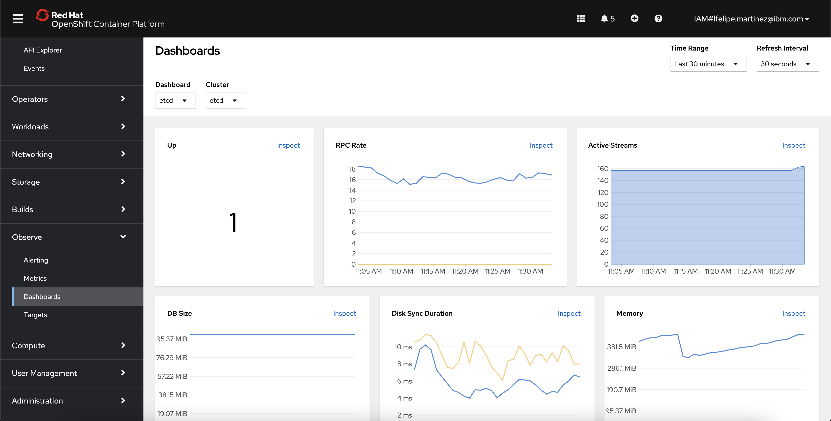
Notes:
New TCO with updated pricing - our total cost decreased from ~$71,000 to ~$44,000 and therefore making our TCO significantly lower than other Kube Services.

Slide 47
Secrets

Slide 48
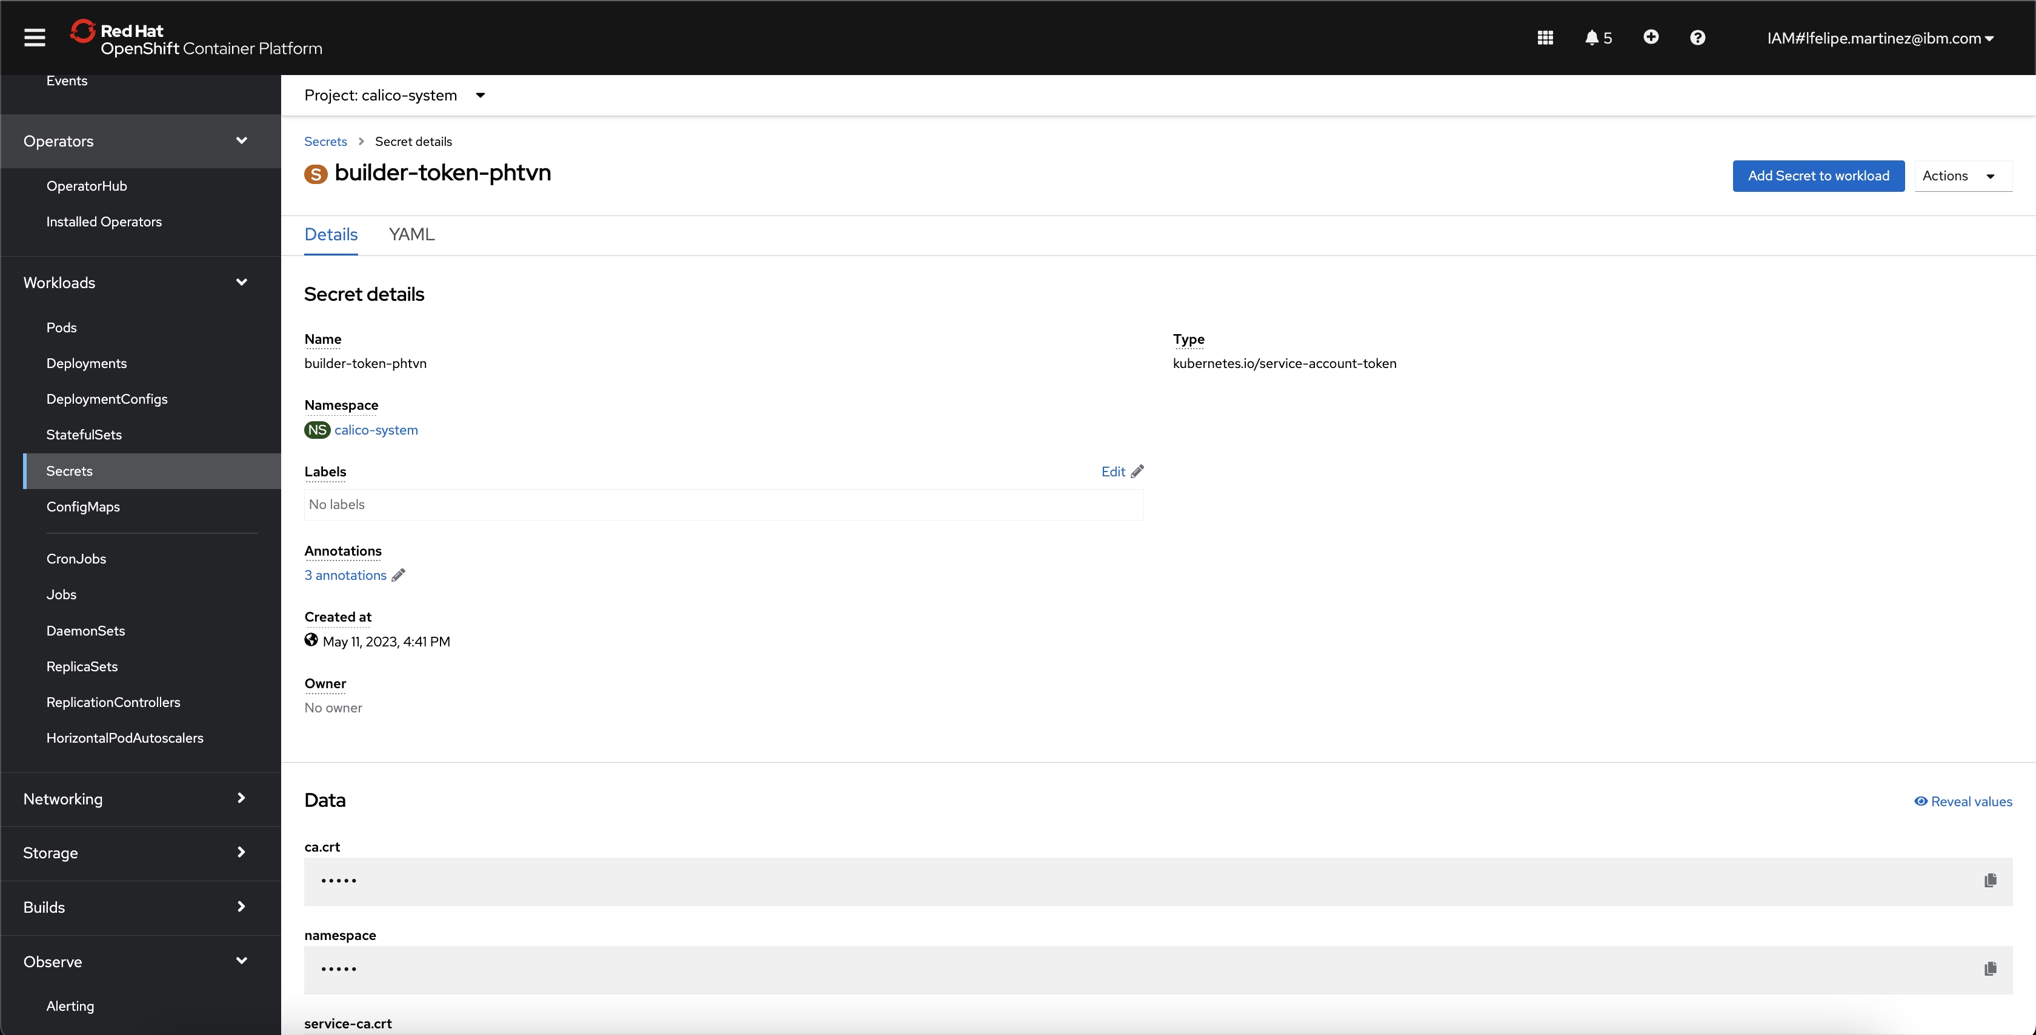
Notes:
New TCO with updated pricing - our total cost decreased from ~$71,000 to ~$44,000 and therefore making our TCO significantly lower than other Kube Services.

Slide 49
Routes

Slide 50
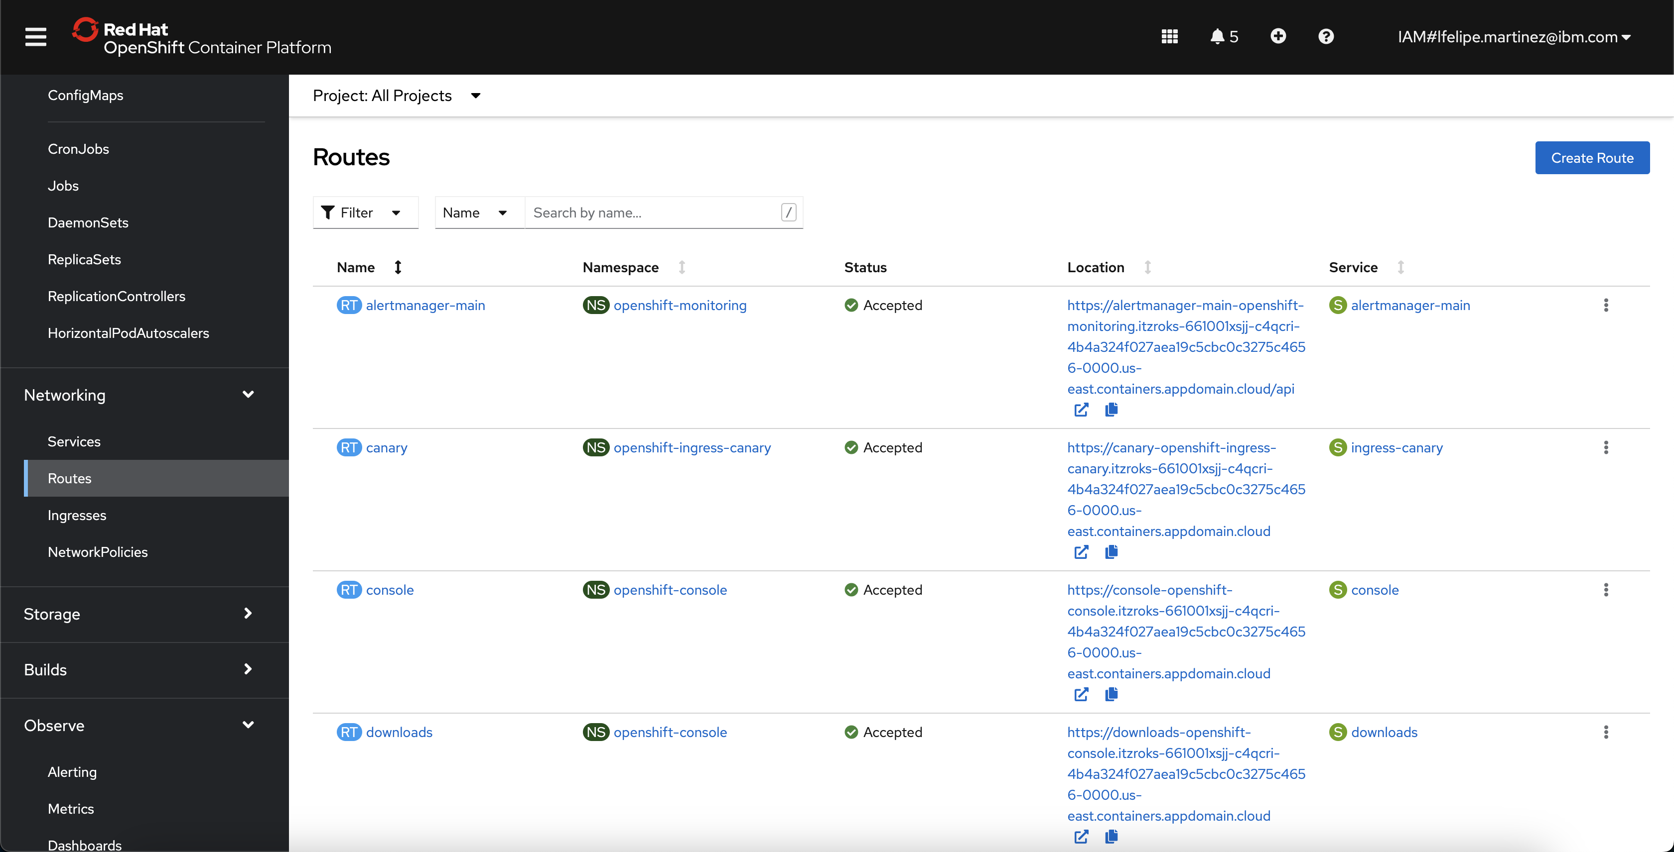
Notes:
New TCO with updated pricing - our total cost decreased from ~$71,000 to ~$44,000 and therefore making our TCO significantly lower than other Kube Services.

Slide 51
PODs

Slide 52
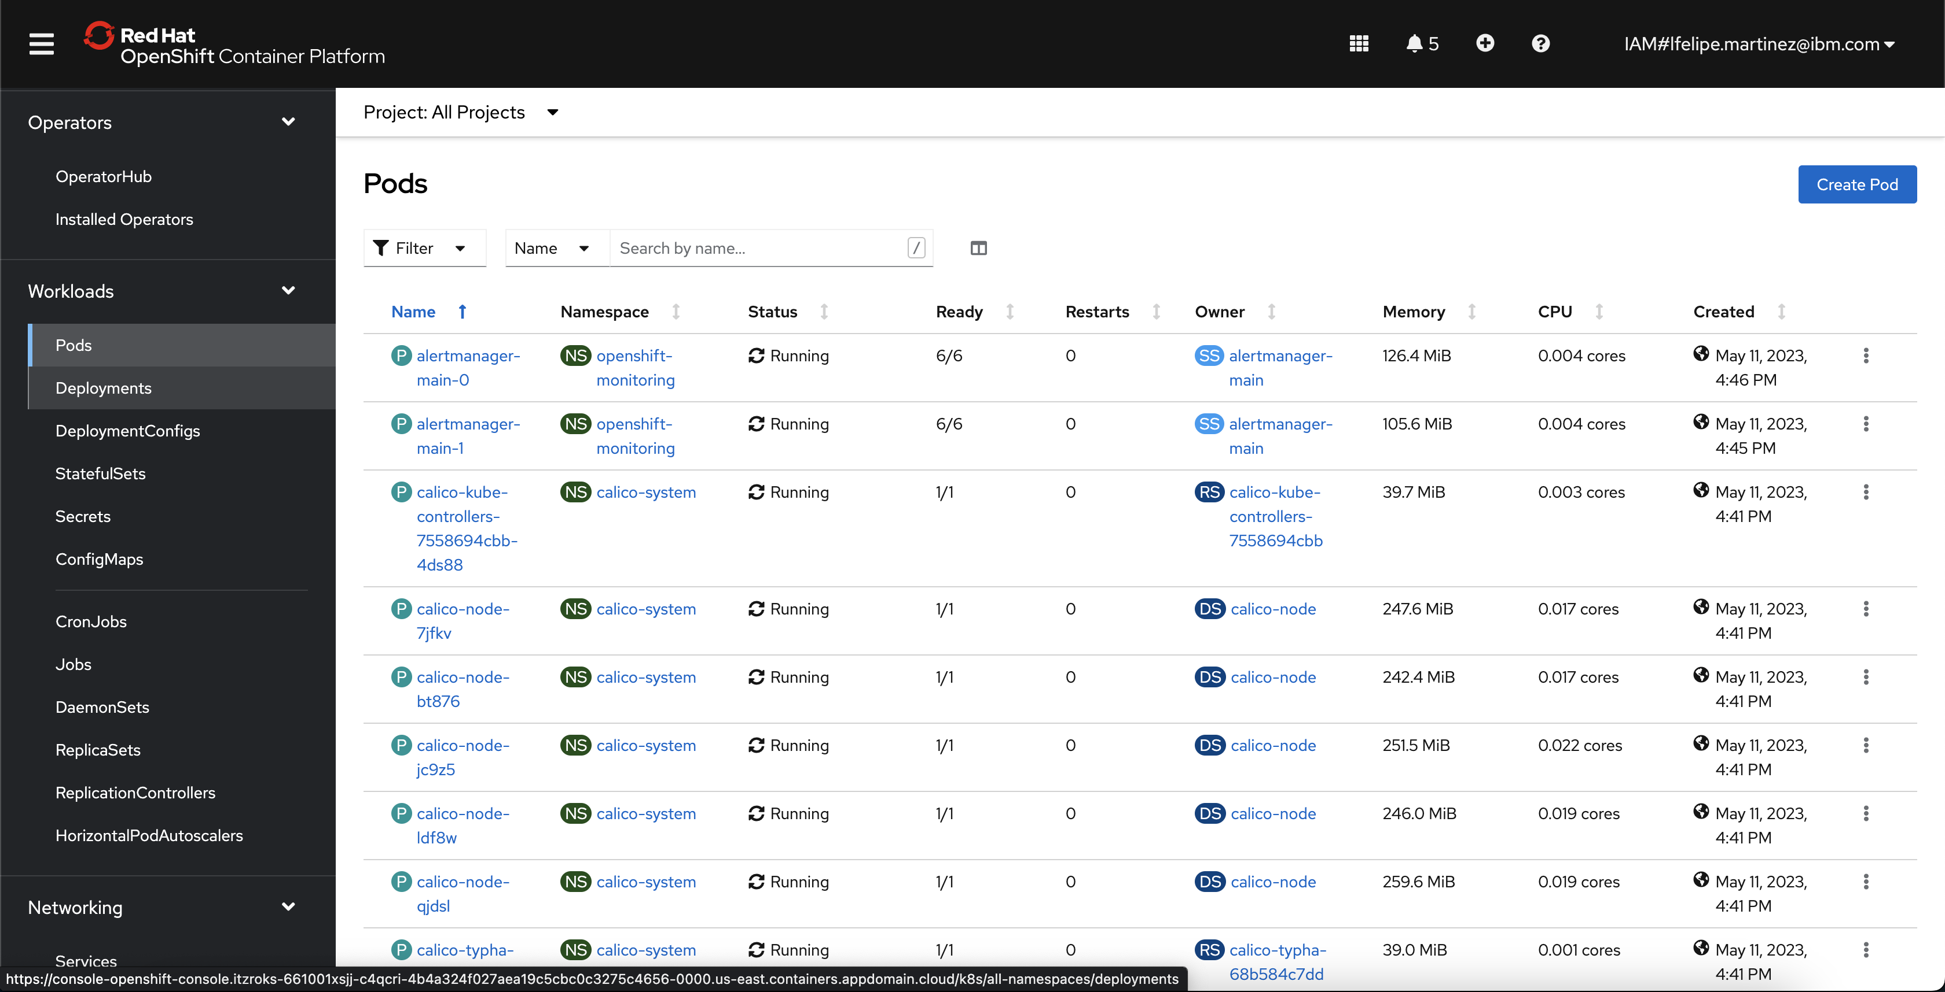
Notes:
New TCO with updated pricing - our total cost decreased from ~$71,000 to ~$44,000 and therefore making our TCO significantly lower than other Kube Services.

Slide 53
Operators

Slide 54
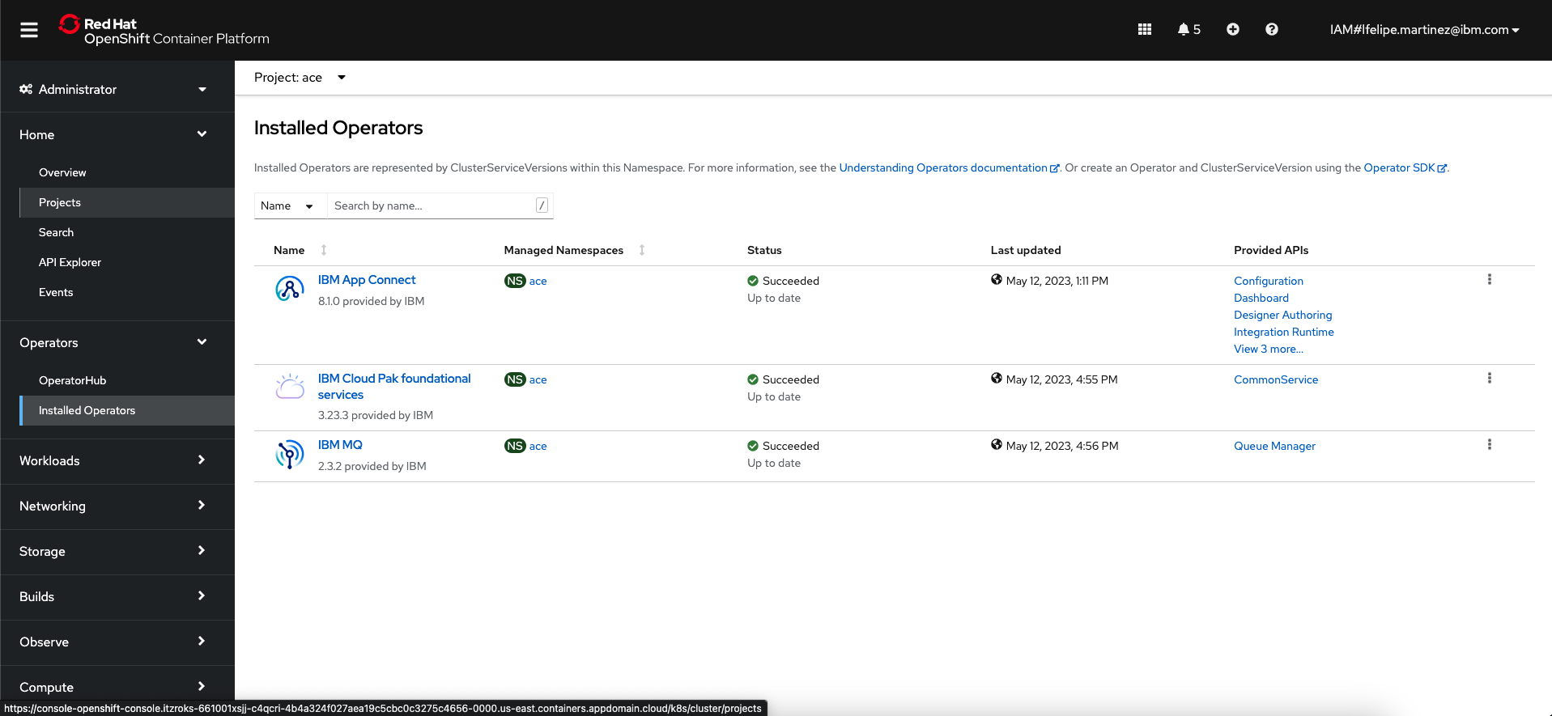
Notes:
New TCO with updated pricing - our total cost decreased from ~$71,000 to ~$44,000 and therefore making our TCO significantly lower than other Kube Services.

Slide 55
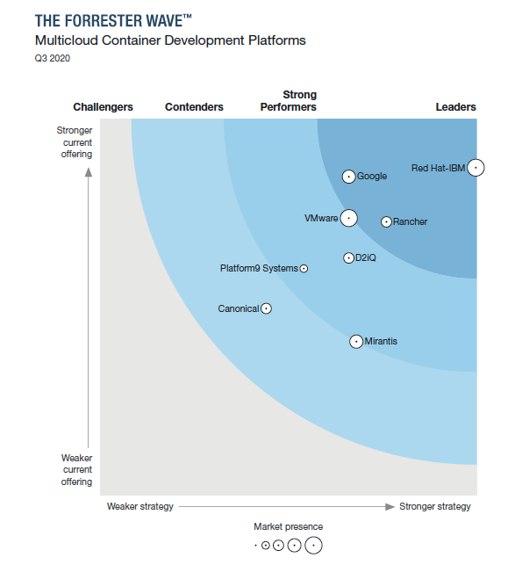
Pioneering
Red Hat Named a Leader by Independent Research Firm in Multicloud Container Development Platforms Evaluation
Report states: “Red Hat-IBM offers the leading platform for developers and operators”.
“OpenShift is the most widely deployed multicloud container platform and boasts powerful development and unified operations experiences across many public and on-premises platforms.
Red Hat pioneered the ‘operator’ model for infrastructure and application management and provides a rich partner ecosystem and popular marketplace.
Red Hat and IBM aim to make ‘build once, deploy anywhere’ a reality; both companies’ deep commitment to Kubernetes-powered modernization has paid off, moving OpenShift further ahead of the market since Forrester’s last evaluation.”

Slide 56
Hans-on!!!

Slide 57


